Slide 1
Contribution of Software Application for Māori
Aligning with Ngā Tikanga Paihere Principles

Slide 2
Introduction
Our software application is designed to align with Māori values by incorporating the principles of Ngā Tikanga Paihere.
These principles ensure ethical, culturally appropriate, and responsible data practices that serve the Māori community effectively.

Slide 3
Pūkenga & Whakapapa
Emphasizes having appropriate expertise, skills, and relationships with communities.
Our software ensures cultural competence and community engagement.

Slide 4

Pono & Tika
Focuses on maintaining public confidence and trust in data use. We implement transparency and ethical AI principles.

Slide 5
Wānanga & Kaitiaki
Highlights the importance of using good data standards and practices. Our platform follows best data governance practices.

Slide 6
Wairua & Mauri
Ensures clear purpose and action in data activities. Our system is designed with intent and respect for data sovereignty.

Slide 7
Tapu & Noa
Aims to balance benefits and risks in data use. We apply risk mitigation strategies and equitable access to technology.
See help video: https://www.youtube.com/watch?v=Lf5kuHEtdhQ

Slide 8
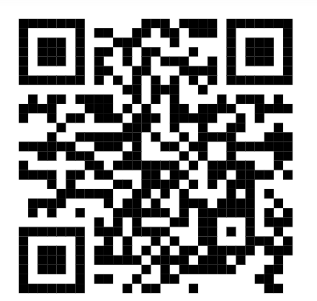
Data Governance & Sovereignty
Māori Data Sovereignty: refers to the inherent rights and interests that Māori have in relation to the collection, ownership, & application of Māori data.
See help link: https://www.youtube.com/watch?v=EOz8JGnHZso
Notes:
Ref: https://share.google/UI5qyutpX3vc33btk

Slide 9

Q/A?

